Slide 1
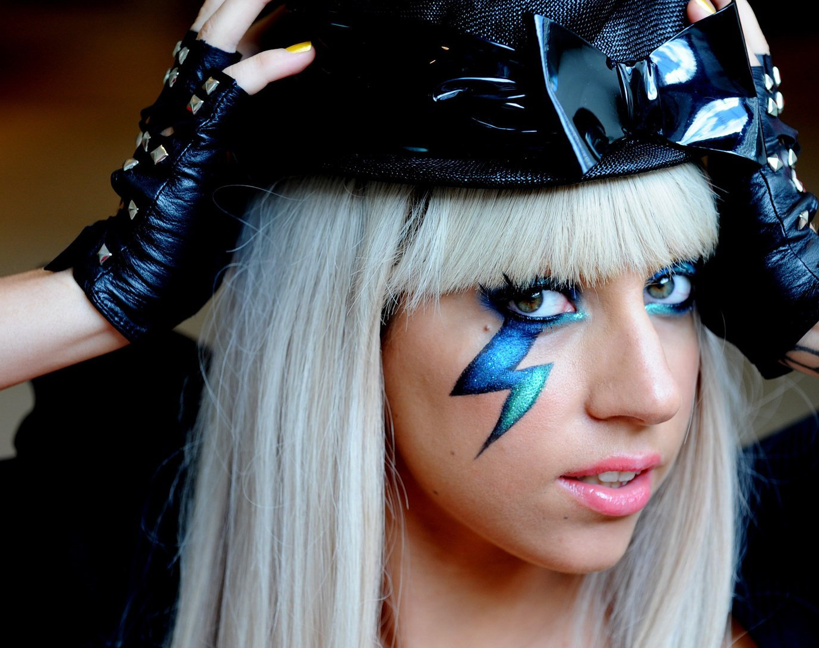
LADY GAGA FAN PAGE
BY 10A J.ENKHRIIMAA

Slide 2
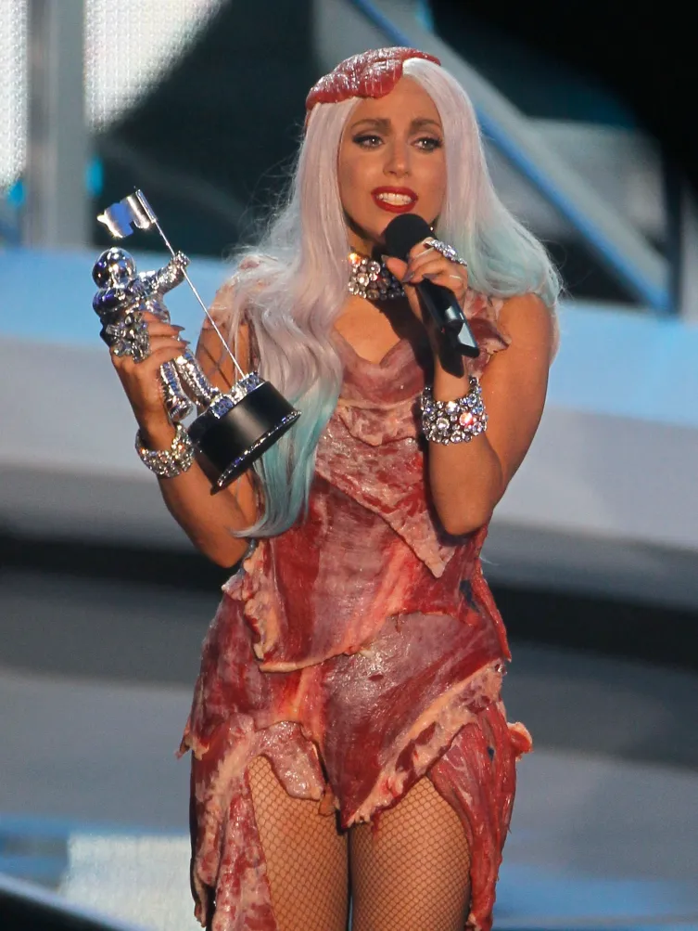
WHO IS LADY GAGA? She was born in march 28th , 1986 in Manhattan,New York city Her full name is Stefani Joanne Angelina Germanotta

Slide 3

Lady Gaga is among the few artists to have won an Emmy, Grammy, and Oscar, and is on the verge of achieving EGOT status. She has received 14 Grammy Awards, 18 MTV Video Music Awards, and recognition from the Songwriters Hall of Fame. Her philanthropic efforts focus on mental health awareness and LGBTQ+ rights through her Born This Way Foundation.

Slide 4

Musical Evolution
Gaga's debut album, The Fame (2008), propelled her into the spotlight with hits like "Just Dance" and "Poker Face." She continued to evolve artistically with subsequent albums:
Born This Way (2011): A dance-pop album embracing themes of self-empowerment and LGBTQ+ rights.
Artpop (2013): A blend of electronic music and art, though it received mixed reviews.
Cheek to Cheek (2014): A jazz collaboration with Tony Bennett.
Joanne (2016): A country-influenced album reflecting personal themes.
Chromatica (2020): A return to dance-pop, featuring the hit "Stupid Love."
Mayhem (2025): A synth-pop album exploring themes of chaos and identity, featuring the Grammy-winning single "Die with a Smile" with Bruno Mars

Slide 5

Thank you

